Slide 1
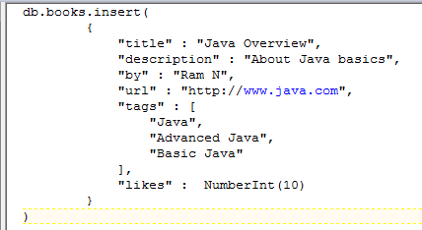
MongoDB - Insert Document
This command is used to insert document in MongoDB collection.
Syntax
db.COLLECTION_NAME.insert(document)
Example to Insert Single Document
Here books is our collection name. If the collection doesn't exist in the database, then MongoDB will create this collection and then insert a document into it.
In the inserted document, if we don't specify the _id parameter, then MongoDB assigns a unique ObjectId for this document.
db.books.find({}).pretty()

Slide 2
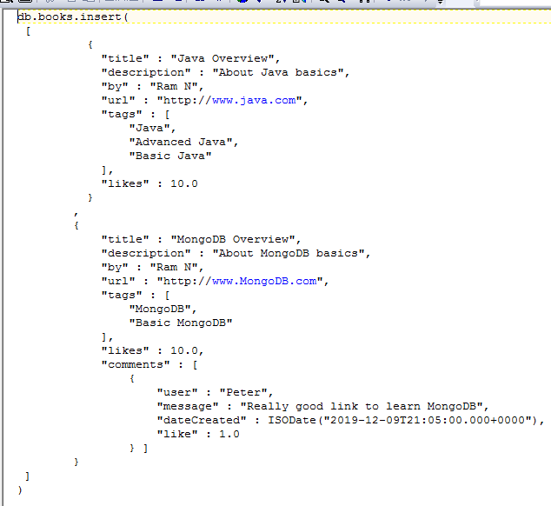
MongoDB - Insert Document
Example to Insert Multiple Documents
To insert multiple documents in a single query, you can pass an array of documents in insert() command.

